Slide 1

Hi, I am Mona

Slide 2
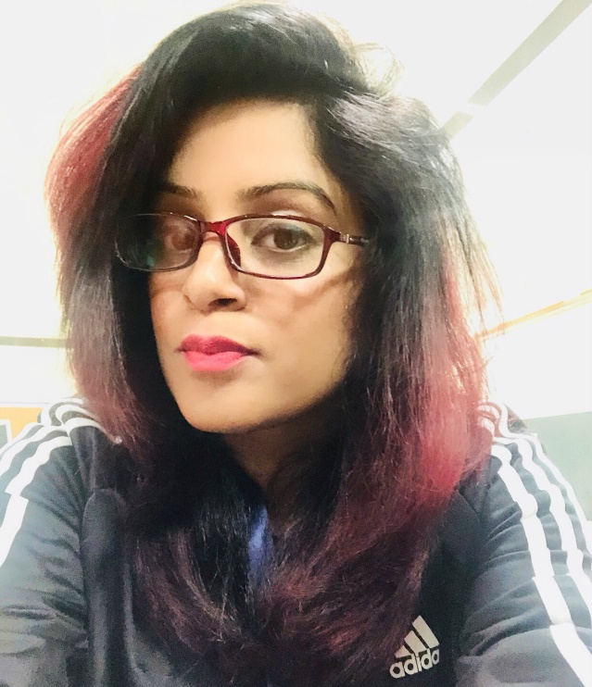



www.ashitandon.com

